Slide 1


Developing a Diabetes Indicator Document through RMarkdown
Victor Yu, The Strategy Unit
Notes:
Illustrate some of the possibilities of what Rmarkdown is capable of creating

Slide 2

Background of the Document
“Diabetes Improvement and Assurance Framework”
PDF report collating diabetes metrics for CCGs and STPs across West Midlands
Previous versions – elementary, time-consuming
Notes:
Request from West Midlands Clinical Network – CVD Team
Indicator report – Trends for improving commissioning and service delivery – report used by NHSE network quality/clinical leads to drive improvement to services and outcomes, ultimate goal of improving their local diabetes patient population, support in developing local pathway
Previous versions quite rudimentary – time-consuming, resource-intensive, non-automated, refreshing each year - cumbersome

Slide 3
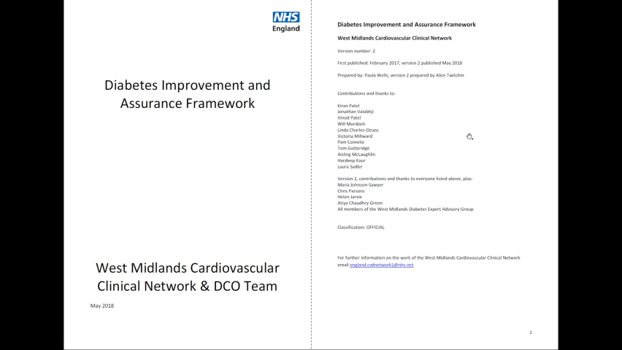

Slide 4
Background of the Document
“Diabetes Improvement and Assurance Framework”
PDF report collating diabetes metrics for CCGs and STPs across West Midlands
Previous versions – elementary, time-consuming
Notes:
Request from West Midlands Clinical Network – CVD Team
Indicator report – Trends for improving commissioning and service delivery – report used by NHSE network quality/clinical leads to drive improvement to services and outcomes, ultimate goal of improving their local diabetes patient population, support in developing local pathway
Previous versions quite rudimentary – time-consuming, resource-intensive, non-automated, refreshing each year - cumbersome

Slide 5
Requirements of the Document
Improve upon visual aspects
Incorporation of text formatting
Benchmark against England values (RAG ratings)
Sparklines for historical data
Aggregation of CCG data where STP data not readily available
Automated for future iterations

Slide 6
Why R and RMarkdown?
I know R
Data importation capacities
Methods for wrangling
Powerful capacities for dynamic report-generation
Incorporate HTML styling, text formatting, R scripting all-in-one
Reproducible
Notes:
Previous knowledge of Tableau – but not available as propriety software
Not so much of Rmarkdown, knew it was this weird tab in Rstudio which looked like an R script editor, but slightly different
R scripting and outpu
Good opportunity to learn more about an area of R I didn’t have familiarity with

Slide 7
Process chart
Create reference data frames
Data importation (fingertips, Excel spreadsheets)
Wrangling
RMarkdown script creation
1) HTML styling 2) R code chunk creation 3) Text insertion
Export through Pandoc to HTML
Convert to PDF through wkhtmltopdf
Extract for relevant CCGs, STPs, Trusts

Slide 8
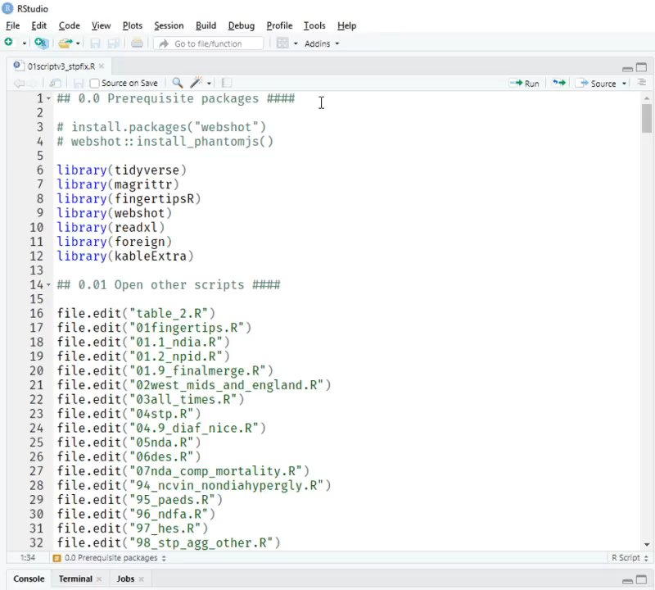
Importing in the data
Data frame holding key info on CCGs, STPs, and providers
FingertipsR, NDA, NPDA, QOF +
Data frame for initial set of indicators
Map/lapply featured a lot – drawing in data
Notes:
Through PHE’s own package, connect to their own API, no need to download and extract manually

Slide 9
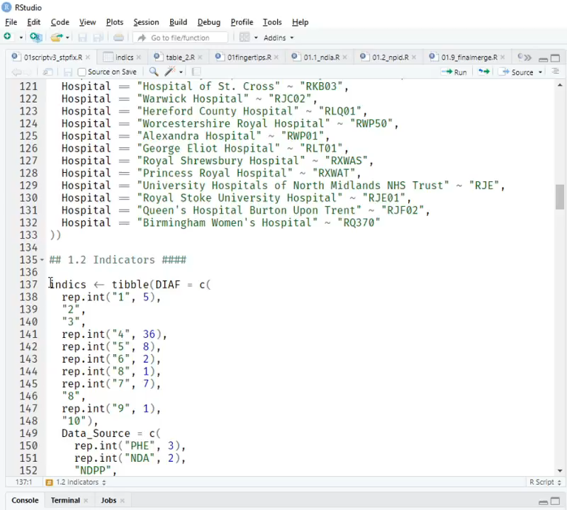
Importing in the data
Data frame holding key info on CCGs, STPs, and providers
FingertipsR, NDA, NPDA, QOF +
Data frame for initial set of indicators
Map/lapply featured a lot – drawing in data
Notes:
Through PHE’s own package, connect to their own API, no need to download and extract manually

Slide 10
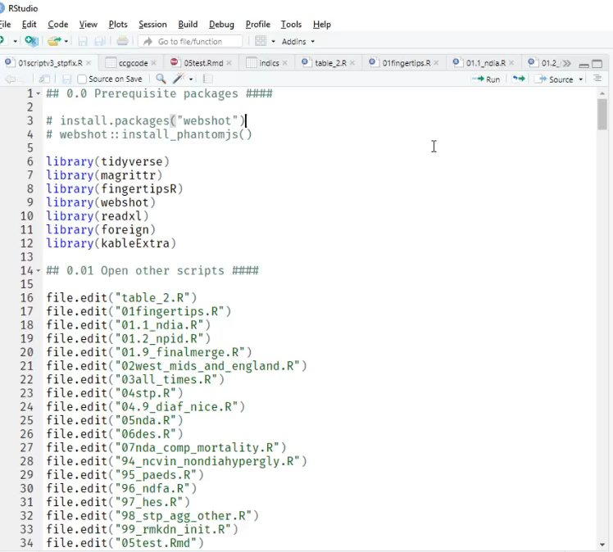
The RMarkdown Script
Saving and inserting the environment
HTML styling
R code chunks
Markdown text formatting
Image insertion

Slide 11
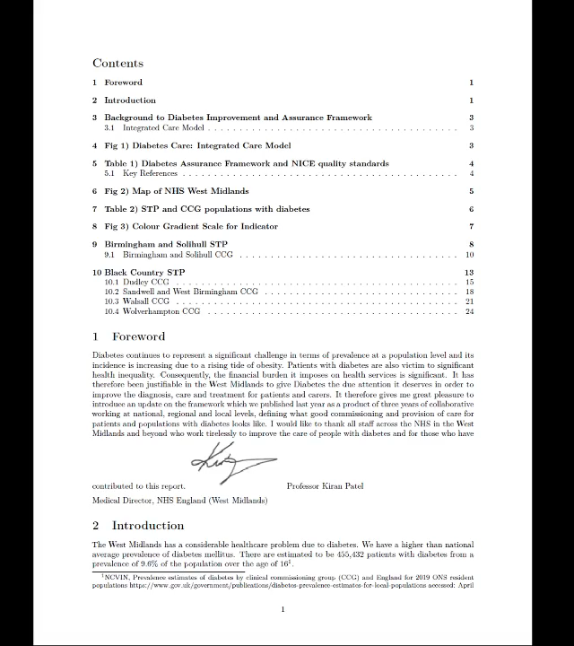
Generating the document
Initial exports to .pdf through Pandoc
Export to .html
Convert to .pdf through wkhtmltopdf
Notes:
Did not look good!

Slide 12
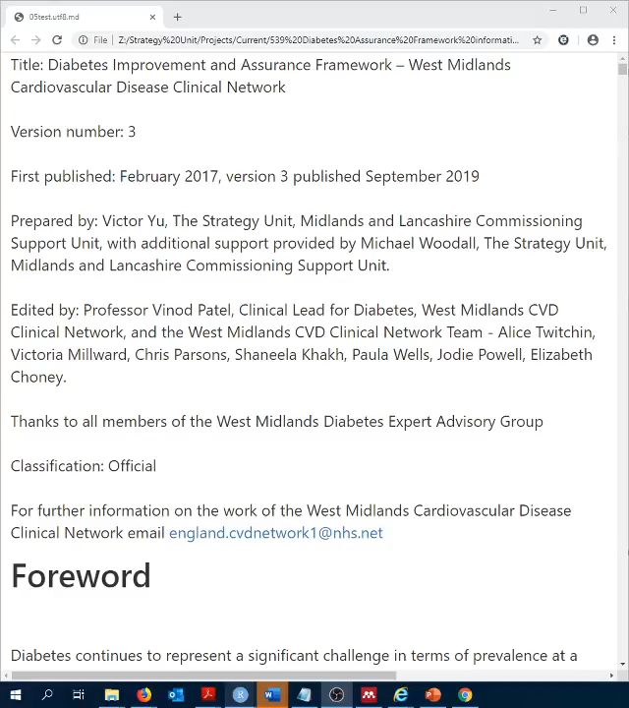
Generating the document
Initial exports to .pdf through Pandoc
Export to .html
Convert to .pdf through wkhtmltopdf
Notes:
Did not look good!

Slide 13
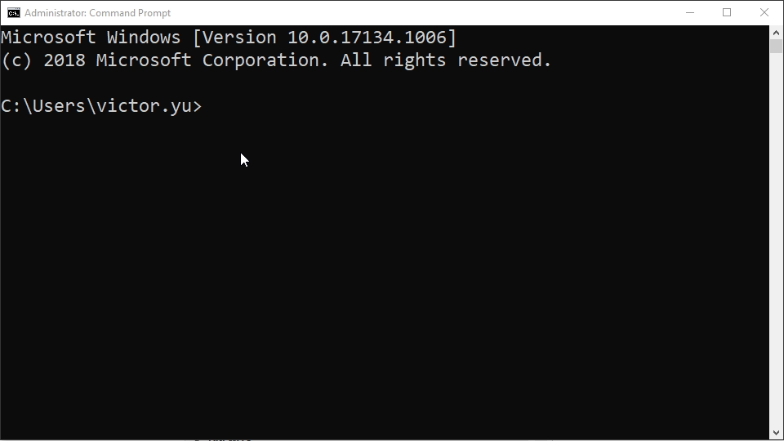
Generating the document
Initial exports to .pdf through Pandoc
Export to .html
Convert to .pdf through wkhtmltopdf
Notes:
Did not look good!

Slide 14
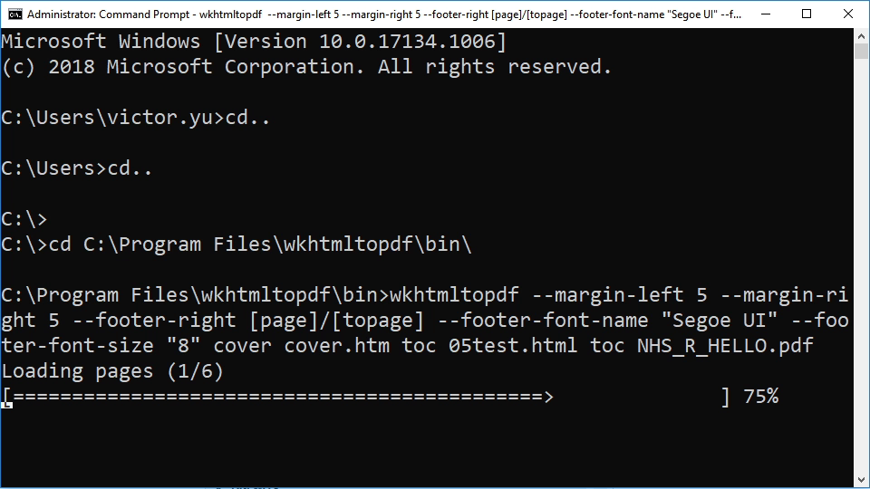
Generating the document
Initial exports to .pdf through pandoc
Export to .html
Convert to .pdf through wkhtmltopdf
Notes:
Did not look good!

Slide 15
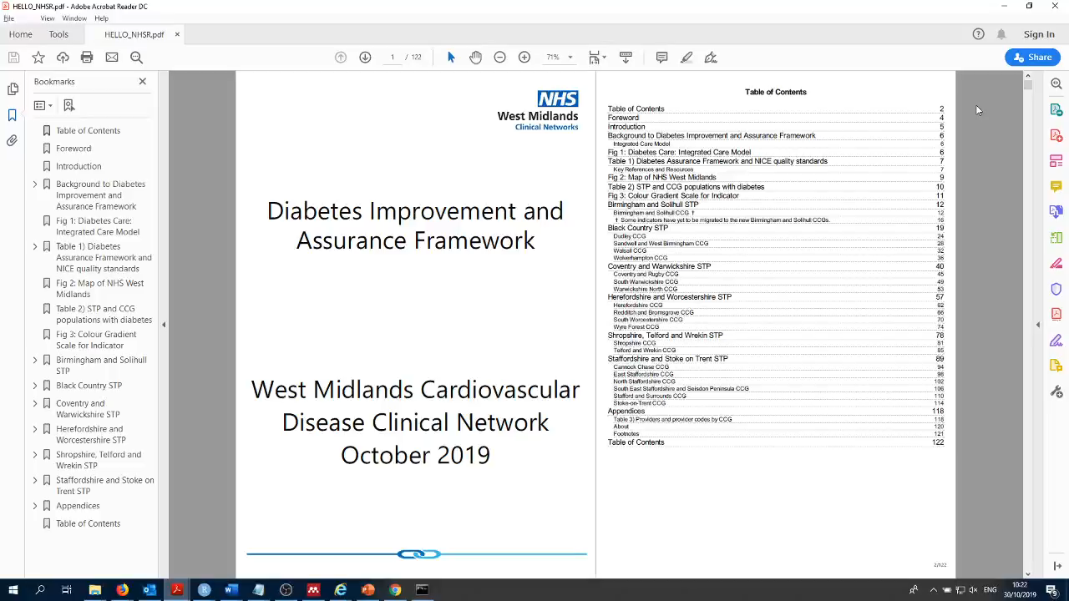

Slide 16
Process chart
Create reference data frames
Data importation (fingertips, Excel spreadsheets)
Wrangling
RMarkdown script creation
1) HTML styling 2) R code chunk creation 3) Text insertion
Export through Pandoc to HTML
Convert to PDF through wkhtmltopdf
Extract for relevant CCGs, STPs, Trusts

Slide 17
Concluding remarks
Illustrate potential of RMarkdown in creating and designing documents
Benefits of R in saving time and resources
Learning by doing
Acknowledging imperfections
Notes:
Reports, presentations, dashboards
Templates – academic papers, posters
Learning by doing – parameters, text formatting, chunk codes,
Html/LaTeX – to really create innovative, colourful reports for stylistic rendering

